Slide 1
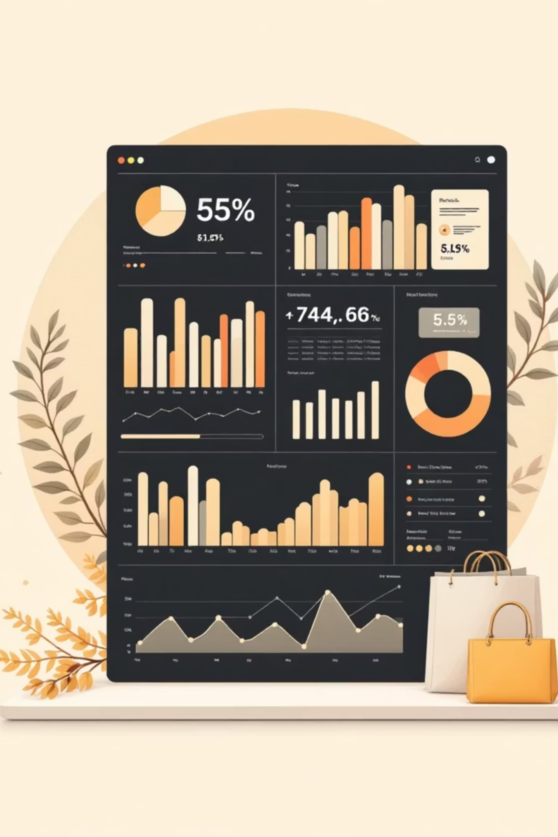
Customer Shopping Behavior Analysis
Analyzing 3,900 customer transactions to uncover patterns that drive revenue growth, retention, and strategic decision-making.

Slide 2
PROJECT OVERVIEW
Project Objective & Approach
Business Goal
Analytics Workflow
Dataset Scope
Identify patterns supporting revenue growth, customer retention, and product performance optimization.
Real-world simulation: clean raw data, analyze with SQL, visualize insights for stakeholders.
3,900 transactions across 18 features including customer attributes, purchases, and behavior.

Slide 3
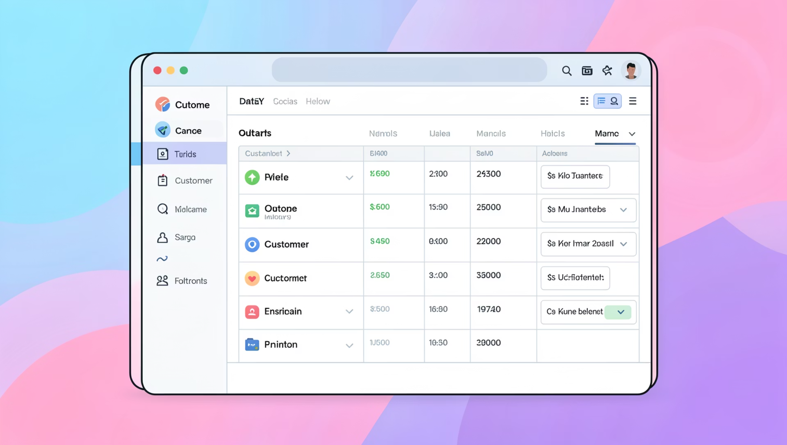

Dataset Structure
Key Data Categories
Customer Attributes: Age, Gender, Location, Subscription Status
Purchase Details: Item, Category, Amount, Season
Behavioral Indicators: Previous Purchases, Discounts, Shipping, Reviews
Minor missing values in Review Rating column required standardization for analysis.

Slide 4
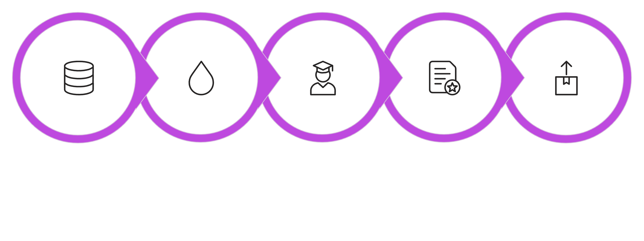

DATA PREPARATION
Feature Engineering Process
Handle Missing Values
Load & Explore
Standardize Columns
Engineer Features
Database Export
Python-based cleaning in Jupyter Notebook ensured analysis-ready data. Key engineered features included Age Group segmentation and Purchase Frequency conversion to numeric values.

Slide 5
SQL Business Analysis
Cleaned dataset loaded into PostgreSQL for enterprise-level analysis, answering 10 critical business questions.
01
02
03
Revenue by Gender
High-Spending Discount Users
Top-Rated Products
04
05
Shipping Impact Analysis
Customer Segmentation

Slide 6
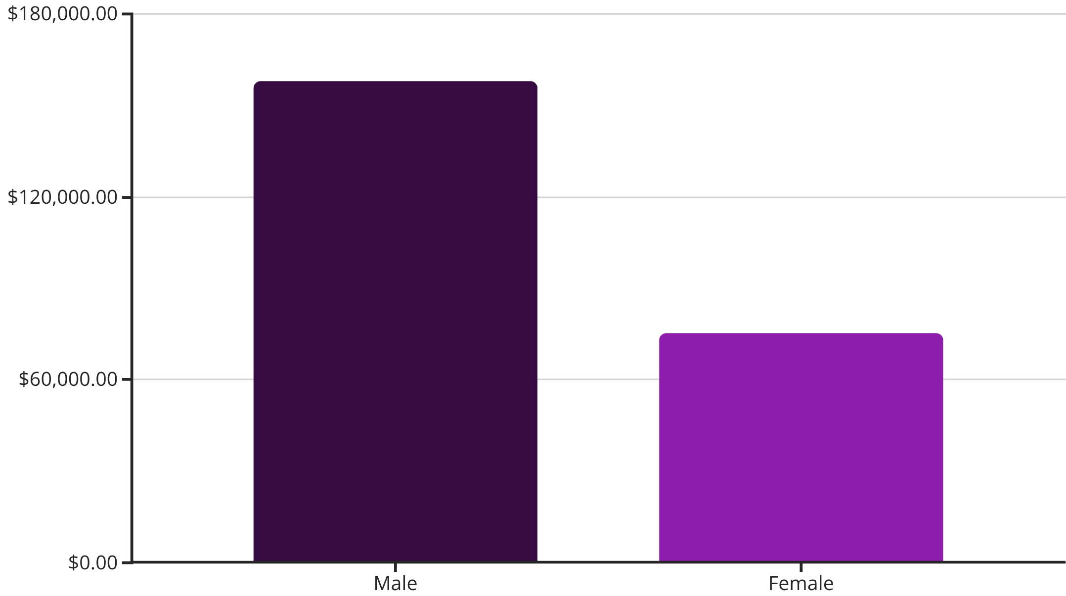
Revenue Insights
Gender Revenue Comparison
Male customers generate 2.1x more revenue than female customers, representing 68% of total revenue.
Discount Impact
839 high-spending customers used discounts, with purchase amounts ranging from $62-$97.

Slide 7

Customer Segmentation Analysis
Segment Distribution
3116
701
83
Loyal Customers
Returning
New Customers
80% of customer base
18% of customers
2% of customer base

Slide 8
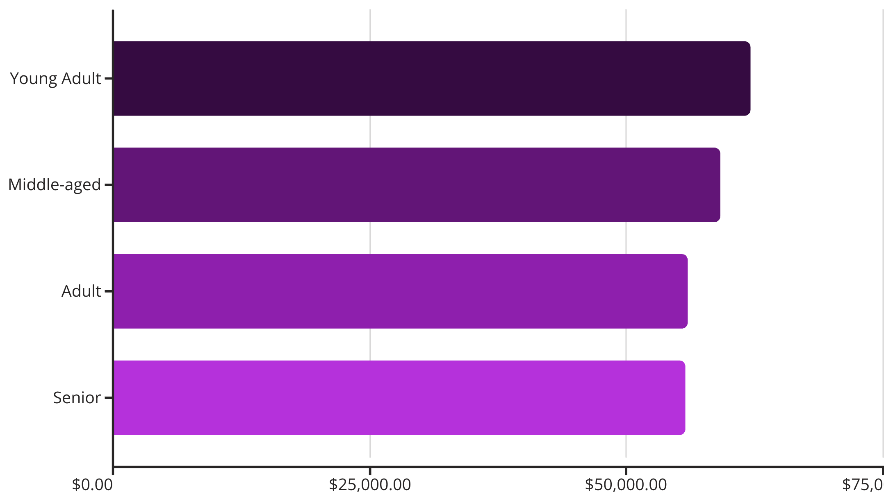
Subscription & Age Group Performance
Key Findings
Young Adults lead revenue generation. Only 27% of customers subscribe, yet subscribed customers show strong repeat purchase behavior (958 of 3,476 repeat buyers).
Average spend remains consistent: $59.49 (subscribed) vs $59.87 (non-subscribed).

Slide 9

Interactive Dashboard
Key Metrics
Category Performance
Interactive Filters
3.9K customers, $59.76 avg purchase, 3.75 avg rating
Revenue and sales breakdowns across Clothing, Accessories, Footwear, Outerwear
Subscription, gender, category, and shipping type slicers for dynamic analysis

Slide 10



RECOMMENDATIONS
Strategic Business Actions
Strengthen Subscriptions
Loyalty Programs
Optimize Discounts
Enhance benefits to boost 27% subscription rate and increase lifetime value
Target 3,116 loyal customers with rewards to maximize retention
Focus promotions on high-revenue categories and top-rated products
Tools Used: Python (Pandas, NumPy), PostgreSQL, Power BI

